Slide 1
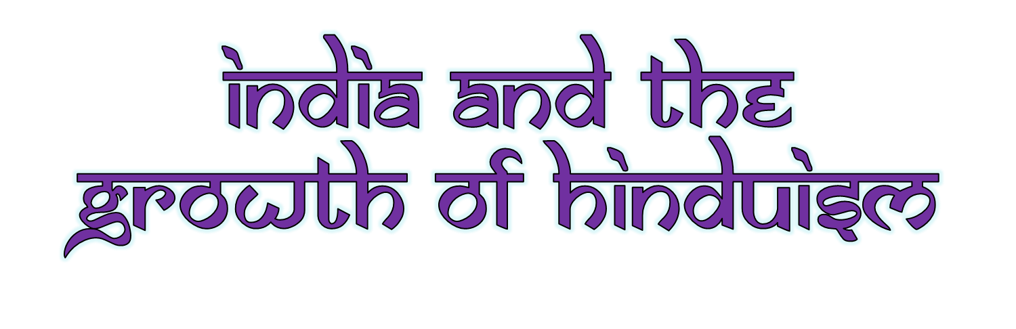
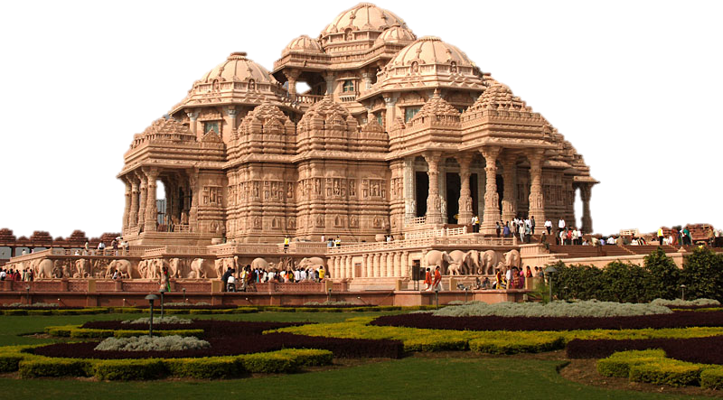

Slide 2

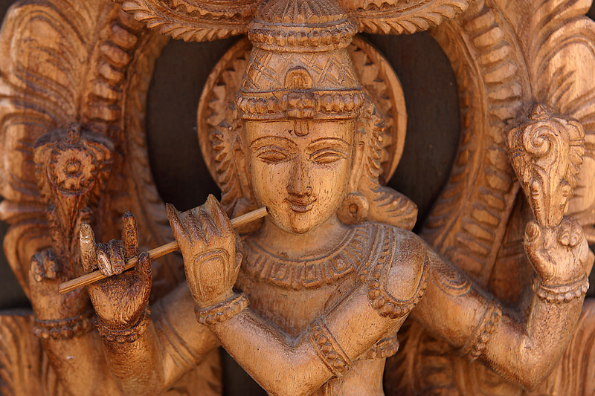
Hinduism
Definition: a way to liberate its followers from illusions and mistakes of everyday life

Slide 3
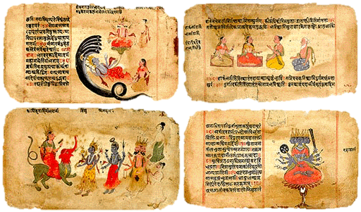
Aryans and the Vedic Age
Aryans invade India, bring sacred scriptures that are first sung then later written in Sanskrit.
Vedas are books of prayer, song, stories, etc.
  tried to explain how a person could achieve liberation from desire and suffering.

Slide 4
Caste System
  In belief:
      Actually 2 concepts – Varna and Jati. 4 Varnas (class level based on temperament) and hundreds of Jatis (based on occupation)
  Varnas –
    Brahmin: study/teach;
    Kshatriya: power/protect;
    Vaisya: earn/give;
    Sudra: serve
  Jati – born into, no mobility. Farmer, barber, shepherd, etc. (occupation)

Slide 5

Varnas in belief:
Brahmins (priests)
Kshatriyas (warriors)
Vaisyas (merchants)
Sudras (laborers)

Slide 6
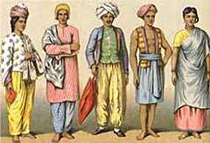
Caste System
A social hierarchy from the Aryans and formalized with laws
  “Caste” –Portuguese for lineage or race
In society:
  varna (caste) = social class or level
    Varna – “Color” in Sanskrit
    varnas decide marriage, job, neighborhood, etc.

Slide 7
Caste System
Pariahs – outside varnas
  “untouchables”
  given “impure” jobs (grave diggers, trash collectors)

Slide 8

Caste System in Society
Brahmins (priests)
Kshatriyas (warriors)
Vaisyas (merchants)
Sudras (laborers)
Pariahs (untouchables)

Slide 9
Gods
All gods are concrete forms of the brahman (“big”)
important gods
  Brahma – creator
  Vishnu – preserver
  Shiva – destroyer
Possibly up to 330 million gods, or only 1

Slide 10
Moksha
The goal is to reach moksha
(The state of perfect understanding of all things – may take several lifetimes)
= soul breaks free of material world and unites with brahman
person
Atman (soul)
body

Slide 11
Definitions
dharma = duty
  Purpose in life is to follow dharma and perform duty
  Include ethical values and obligations
karma = how you live this life determines what you will be in the next
  live a good life
  fulfill your dharma
Samsura (reincarnation) = rebirth of the soul – until one reaches Moksha

Slide 12
Reincarnation Cycle
Soul
Material
Desires
Good
Neutral
Bad
Rebirth
Selfish
Actions
Death
Merits
& Sins

